Slide 1


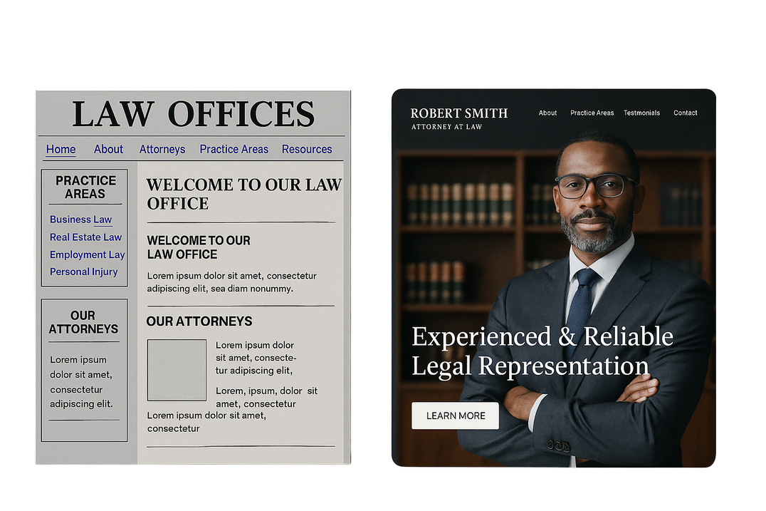
Old
New
Get a face lift.
Refresh your web site in minutes.

Slide 2

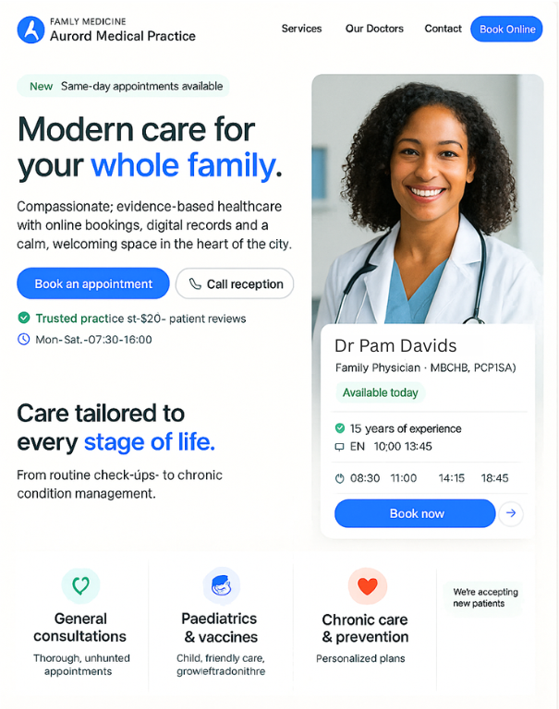
What is Hurri?
AI powered website renovation service that instantly transforms outdated sites into modern, high-converting digital storefronts.
Confidential
2

Slide 3

Why
Millions of professionals operate with outdated websites:
Damage credibility & trust
Reduce client acquisition
Sign of business stagnation
Lacking the time, skills, or urgency to fix it.
Confidential
3

Slide 4
Problem
1
1B+ websites exist; most outdated or low-quality.
Clients judge instantly online, old sites lose trust.
DIY is too complex. Agencies are too expensive.
2
3
Confidential
4

Slide 5
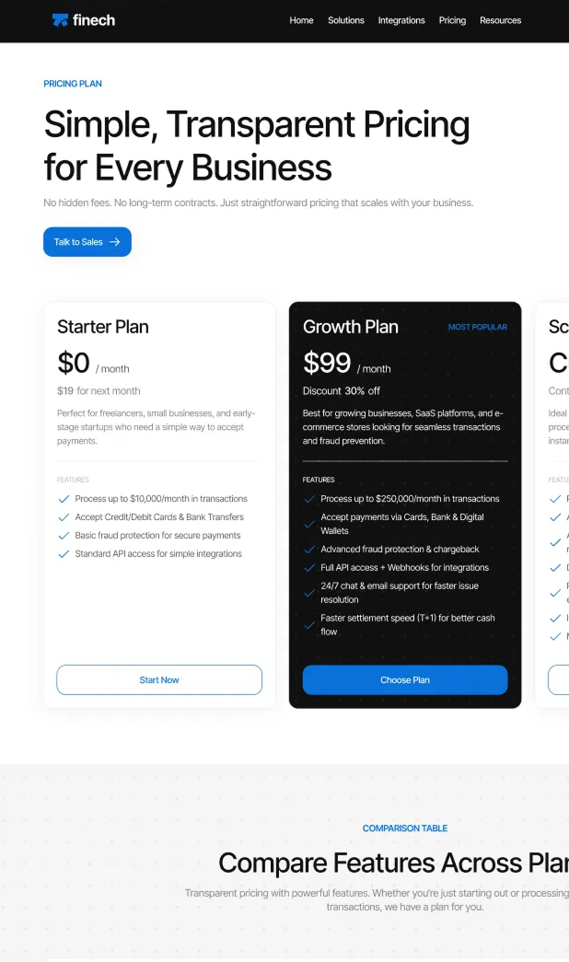
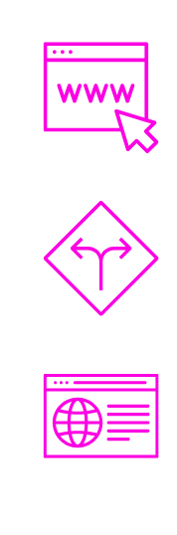
Solution
Hurri proactively renovates the web
AI scans & identifies outdated sites.
Removes decision friction & drives instant conversion.
Delivers “gifted” live preview + instant purchase.
Confidential

Slide 6
How it works
Identify
Scrape
Rebuild
Deliver
Convert
Google Maps API + AI grades outdated sites
Crawler captures full content & structure
AI auto-generates a modern responsive site
Personalized email with screenshot & live preview
Instant editing panel + one-click purchase
Confidential
6

Slide 7

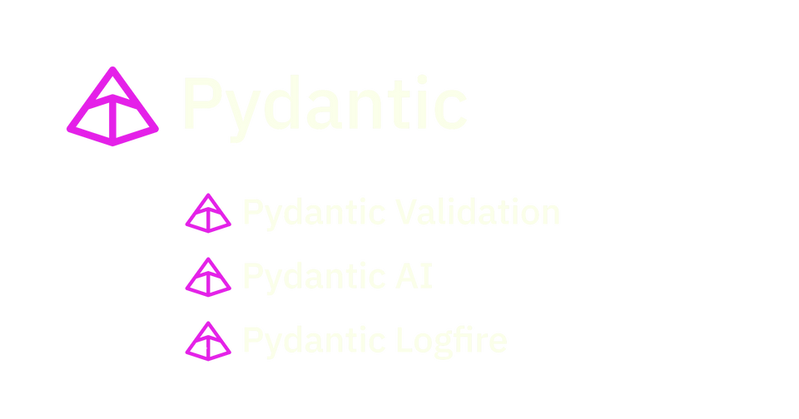




Technology
Tech comprises cutting-edge tools powering automation + scale.
Lead Generation
Google Maps API + Python algorithms.
AI & Content
Beautiful Soup + Pydantic AI for content & restructuring.
Frontend
React Router + modern responsive components.
Backend
Python/Django, REST APIs, PostgreSQL + Celery.
Hosting & Deployment
AWS + Digital Ocean
with auto-scaling infra.
Payments & Comms
SendGrid/Postmark + Stripe and real-time webhooks.
Confidential
7

Slide 8
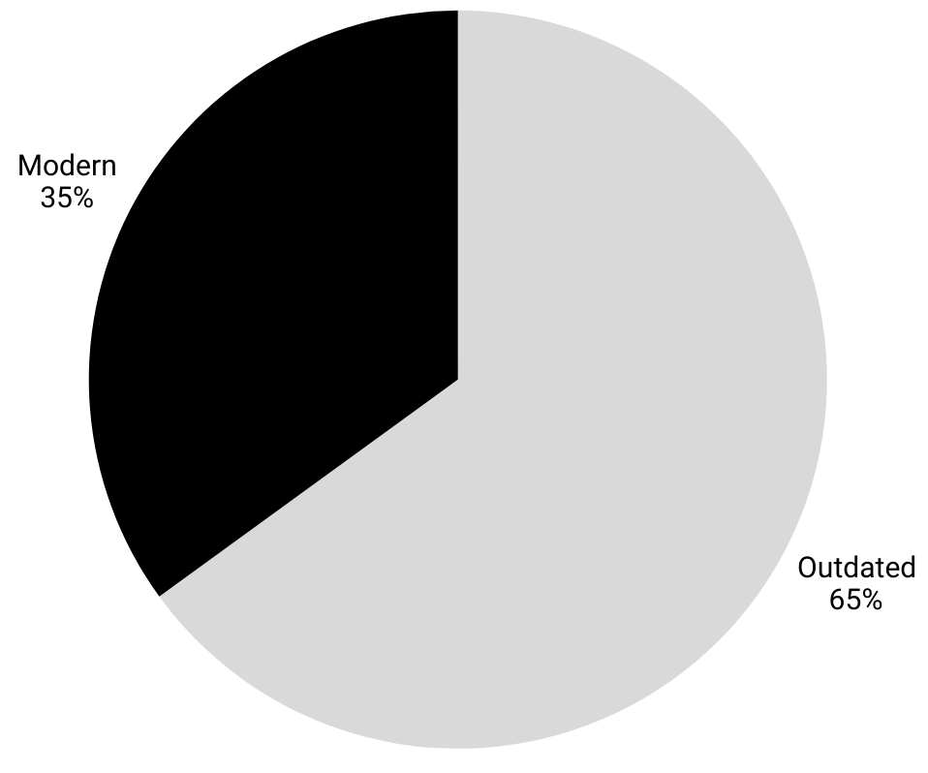
TAM
1.1B+ active websites worldwide
~65% outdated or low-quality
Target market: ~715M professionals & SMB sites
Serviceable market (initial focus: English-speaking professionals): ~50M
Capture goal: 1% = 500k sites @ $250/site → $125M
1bn+ active websites
Confidential
8

Slide 9
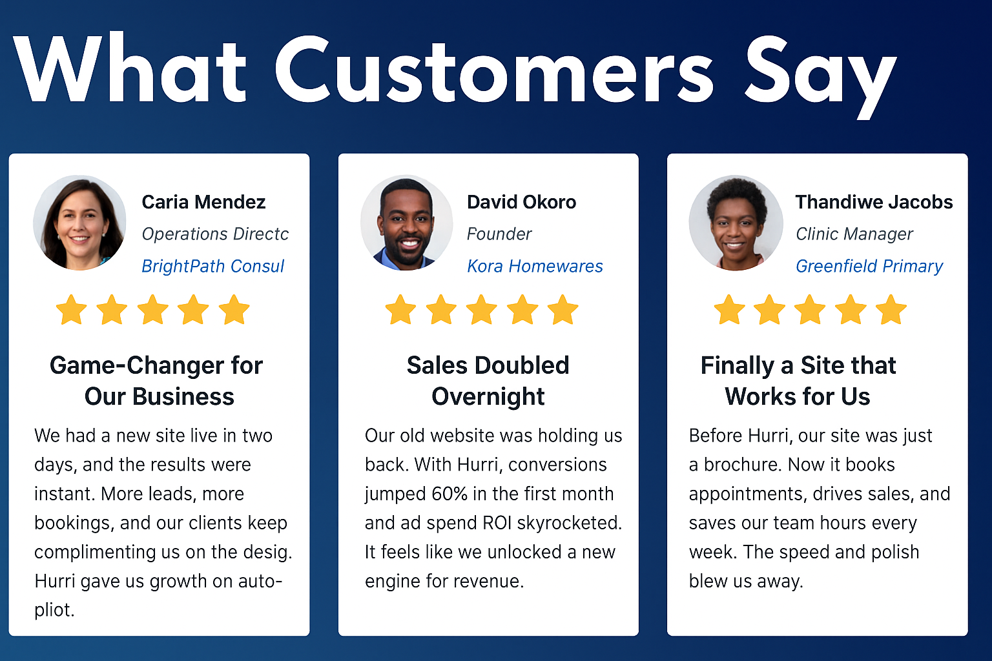
What Customers Say
Carla Mendez
Operations Director
BrightPath Consulting
David Okoro
Founder
Kora Homewares
Thandiwe Jacobs
Clini Manager
Greenfield Primary Care
“Game-Changer for Our Business”
We had a new site live in two days, and the results were instant. More leads, more bookings, and our clients keep complimenting us on the design. Hurri gave us growth on autopilot.
“Sales Doubled Overnight”
Our old website was holding us back. With Hurri, conversions jumped 60% in the first month and ad spend ROI skyrocketed. It feels like we unlocked a new engine for revenue.
“Finally a Site That Works for Us”
Before Hurri, our site was just a brochure. Now it books appointments, drives sales, and saves our team hours every week. The speed and polish blew us away.
Confidential
9

Slide 10
Business Model
Low-Cost, High-ROI Structure
Creation Cost: $10–15/site (AI automated)
Acquisition Cost: $5–10/lead (automated outreach)
Price Point: $250/site (base package)
Margin: 90%+ gross
Conversion: 2–3% of qualified leads
ROI: 15–20x customer acquisition spend
Scale: Zero marginal cost → exponential profitability
90% +
Gross Margin
15-20x
More than COS
$250
Per Site
$15-$25
Cost
100k customers = $25M revenue / $20M profit
Scalable globally with zero incremental cost
Confidential
10

Slide 11
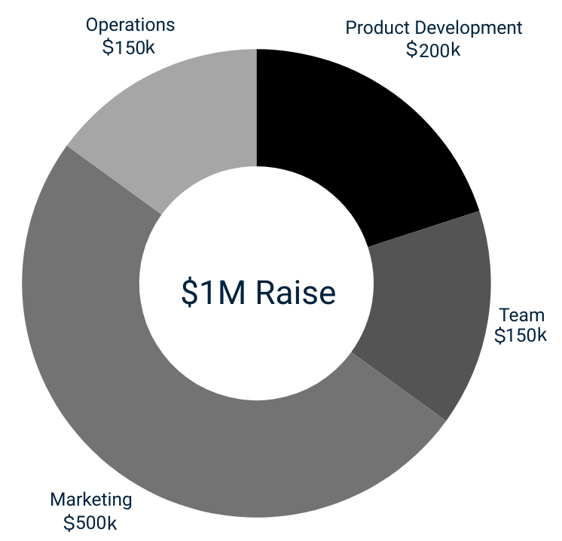
Use of Funds
$1M Raise: Convertible Note – Cap & Collar
Confidential
11

Slide 12

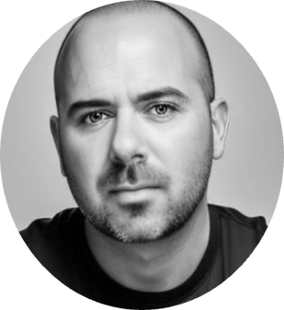



Team
Technologists & AI enthusiasts with deep expertise in web engineering & automation. Proven execution track record with a mission to upgrade the web for everyone, everywhere.
Leora Hessen
Ash Brener
Founder Hello Aida, AI educator and creative technologist in AI, blockchain, & digital transformation. Co-founded NFTy-ART + African NFT Art Collective. Winner of the 2023 Women in Tech Africa Arts Award in Cape Town. Global Finalist for the 2023 Women in Tech Art-Tech category in Dubai
Software Architect par excellence. Proficient in leading-edge development platforms and planetary scale deployments. KaZaa (Altnet). MidletEarth. Airgames. Spin3. FrisB.
Confidential
12

